Slide 1

Arrays and methods

Slide 2
Passing arrays to methods
Two possibilities:
Pass single value of the array to the method
always by value
Pass full array to the method
always by reference

Slide 3
Passing a single value of an array to a method
You can pass a single array element to a method
In same manner as you would pass a variable
Variables are passed by value
Local variables store a local copy of the value

Slide 4
Example
Any existing method from before can also accept a single element from an array
For example, imagine the following method:
private static void DoubleValue(int v)
{
v *= 2;
Console.WriteLine($"\n\nValue of passed parameter doubled in method = {v}\n");
}

Slide 5
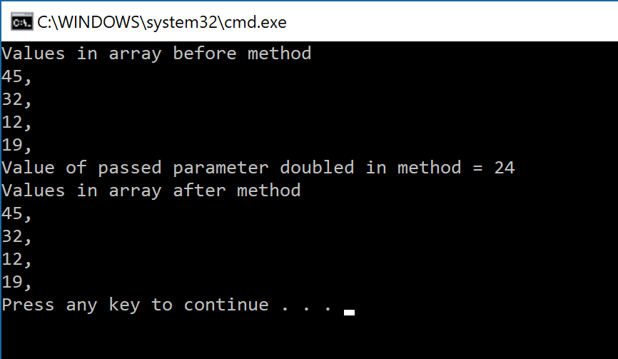
Passing a single value of an array to a method
static void Main(string[] args)
{
int[] ages = { 45, 32, 12, 19 };
Console.WriteLine("Values in array before method");
for (int i = 0; i < ages.Length; i++)
{
Console.Write($"{ages[i]},");
}
DoubleValue(ages[2]);
Console.WriteLine("Values in array after method");
for (int i = 0; i < ages.Length; i++)
{
Console.Write($"{ages[i]},");
}
}
private static void DoubleValue(int v)
{
v *= 2;
Console.WriteLine($"\n\nValue of passed parameter doubled in method = {v}\n");
}
Element 2 (12) passed by value. Only its copy is changed in the method. Not in the original array.

Slide 6
Pass entire array
You can pass an entire array as a parameter
Arrays, like all objects but unlike built-in types, are passed by reference
Method receives actual memory address of the array
Has access to the actual values in the array elements

Slide 7
Methode signature when passing array
No length is allowed in the param syntax:
Forces you to use .Length
Don’t do this! => private static void DoubleArray(int[] v, int length)
private static void DoubleArray(int[] v)
{
for (int i = 0; i < v.Length; i++)
{
v[i] *= 2;
}
}

Slide 8
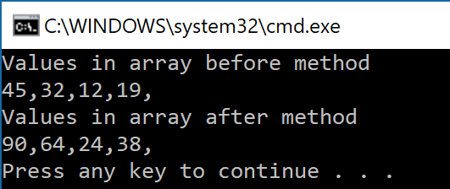
Passing a full array to a method
static void Main(string[] args)
{
int[] ages = { 45, 32, 12, 19 };
Console.WriteLine("Values in array before method");
for (int i = 0; i < ages.Length; i++)
{
Console.Write($"{ages[i]},");
}
DoubleArray(ages);
Console.WriteLine(“\nValues in array after method");
for (int i = 0; i < ages.Length; i++)
{
Console.Write($"{ages[i]},");
}
}
private static void DoubleArray(int[] v)
{
for (int i = 0; i < v.Length; i++)
{
v[i] *= 2;
}
}
Array is passed by reference. And so changing element in the array in the method changes the elements in the original array.

Slide 9
Summary
Two possibilities:
Pass single value of the array to the method => always by value
Pass full array to the method => always by reference
Click here to watch the above animation in your pdf:
https://ericlbarnesblog.files.wordpress.com/2016/06/pass-by-reference-vs-pass-by-value-animation.gif

Slide 10
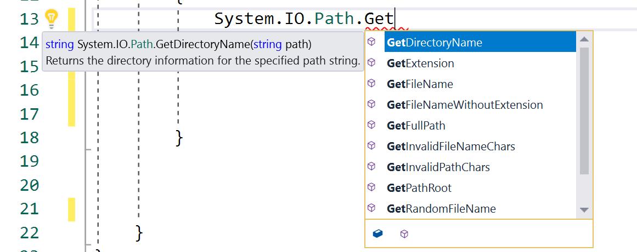
Example of existing .NET methods with array results
Pro-tip: have a look at the System.IO.Path.Getxxxx(); methods!
string[] drives = Environment.GetLogicalDrives();
string[] dirs= System.IO.Directory.GetDirectories(@"c:\");
string[] files = System.IO.Directory.GetFiles(@"c:\temp");

Slide 11

Copying arrays

Slide 12
Array Assignment
Assignment operator (=) does not work as you would think
Assigned operand contains the same address as the operand on the right of the equal symbol
We are simply copying the address, not the array itself
As a result: both variables (ages & newages) now point to the same single array (i.e. we created an alias)
int[] ages = { 45, 32, 12, 19 };
int[] newages;
newages = ages;

Slide 13
Input Values into an Array: a handy method
public static void InputValues(int [ ] temp)
{
string inValue;
for(int i = 0; i < temp.Length; i++)
{
Console.Write($"Enter Temperature {i + 1} ");
inValue = Console.ReadLine( );
temp[i] = Convert.ToInt32(inValue);
}
}
temp contains reference to original array, so this method will fill the original array!

Slide 14
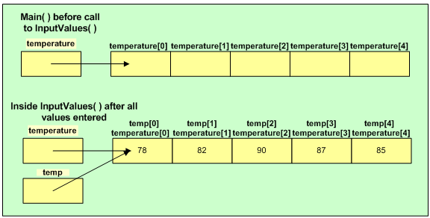
Input Values into an Array (continued)
Example usage to call method:
int [ ] temperature = new int[5];
InputValues(temperature);
Array contents after the InputValues( ) method is called

Slide 15
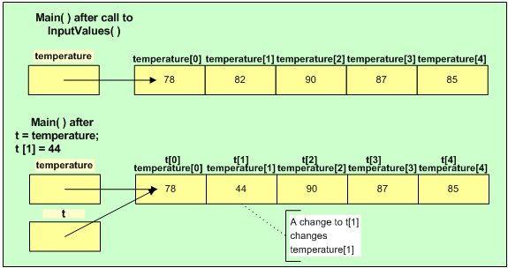
Array Assignment (continued)
Figure 7-8 Assignment of an array to reference another array

Slide 16
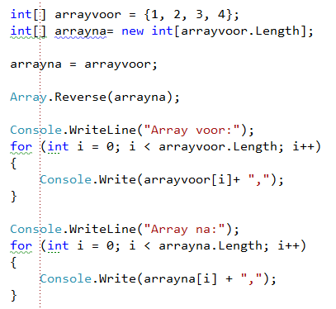

References
Example: suppose your assignment is to Reverse an array. After reversing you have to show both the original and the reversed array.
Wrong solution:

Slide 17
References
! arrayna points to exactly the same reference ☹

Slide 18

Solution
First copy the original array element by element to a freshly created array

Slide 19
Or go simple
Just use Array.Copy() ;)

Slide 20
Startup parameters

Slide 21
Startup parameters in Main
static void Main(string[] args)
{
Console.WriteLine($"Parameter count = {args.Length}");
for (int i = 0; i < args.Length; i++)
{
Console.WriteLine($"Argument {i} = {args[i]}");
}
}
Suppose we start application with: myapplication.exe tim 1981 3
Output:
Parameter count = 3
Argument 0 = tim
Argument 1 = 1981
Argument 2 = 3
Or if you are building dotnetcore app, start with:
dotnet myapplication.dll tim 1981 3

Slide 22
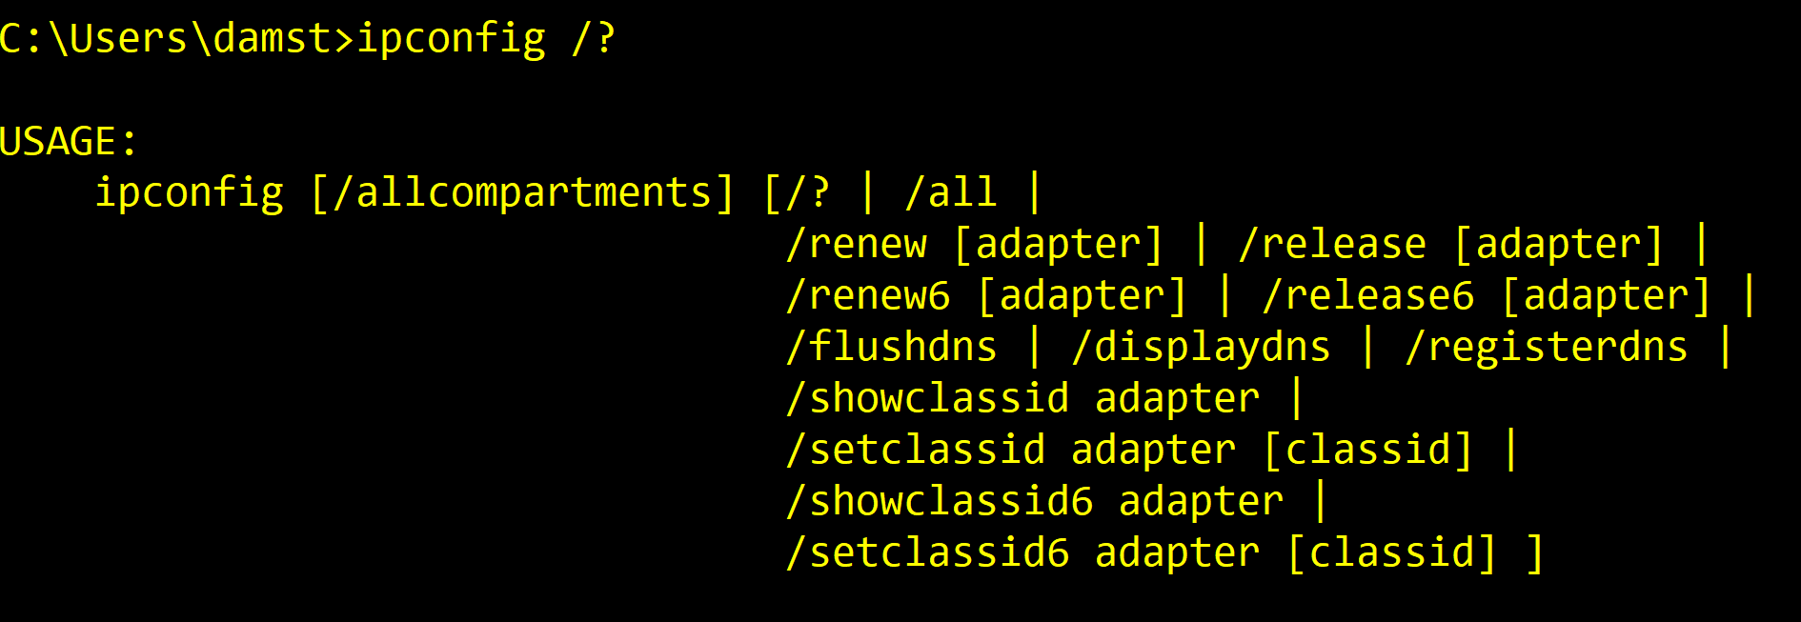
Very usefull to create shell-tools

Slide 23

Multidimensional arrays

Slide 24

Using Multidimensional Arrays
One-dimensional or single-dimensional array
Picture as a column of values
Elements can be accessed using a single subscript
Multidimensional arrays
Require multiple subscripts to access the array elements
Two-dimensional arrays
Have two or more columns of values for each row
Also called rectangular array, matrix, or a table

Slide 25



Any dimension allowed
1D
2D
3D
And what about 4D?? Or 5D?? All allowed!

Slide 26


Slide 27
2-dimensionial arrays
2D-arrays = array of arrays
Create as follows
type [,] arrayname = new type[length1,length2]
For example:
int[,] calendar = new int[7, 4];
string[,] datacolumn = new string[100, 2];

Slide 28
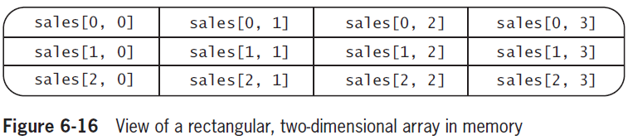
Indexing

Slide 29

Indexing
board
Int 2D-array object op geheugenplek #427
#427
1

Slide 30
More than 2 dimensions?
Not a problem sir
Even more? Sure. But usually very hard to “imagine”, let alone work with.

Slide 31
Initializer syntax for 2D arrays
Notice the extra set of angle brackets:
int[,] rents =
{
{400,450,510 },
{500,560,630 },
{625, 676,740 },
{1000,1250,1600 }
};
string[,] dictionary =
{
{"kast", "armoire","closet", "armario" },
{"kind", "enfant", "child","niño" }//etc
};

Slide 32
Three-dimensional array example
int[,,] rents =
{
{ {200, 300},{400, 600} },
{ {450, 313},{345, 123} },
{ {500, 130},{450, 230} },
{ {600, 630},{950, 630} },
};
Notice another extra set of angle brackets

Slide 33
Using Multidimensional Arrays
int[,] rents =
{
{400,450,510 }, //ground floor: 0 bedrooms, 1 bedroom, 2 bedrooms
{500,560,630 }, //first floor : idem
{625, 676,740 }, //second floor: idem
{1000,1250,1600 } //third floor : idem
};
Console.WriteLine("What floor do you wish to live?(0-3)");
int floor = Convert.ToInt32(Console.ReadLine());
Console.WriteLine("How many bedrooms do you want?(0-2)");
int bedrooms = Convert.ToInt32(Console.ReadLine());
Console.WriteLine($"That will be a monthly rent of {rents[floor,bedrooms]}");

Slide 34
Accessing all elements in a 2D array?
You will need two loops.
How about the .Length? Return total numbers of elements
Use GetUpperBound(x) where x is which dimensional-length you need

Slide 35
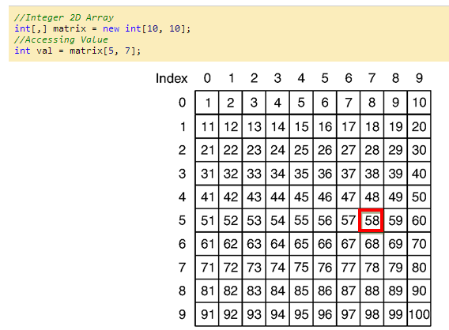
Another example: matrices

Slide 36
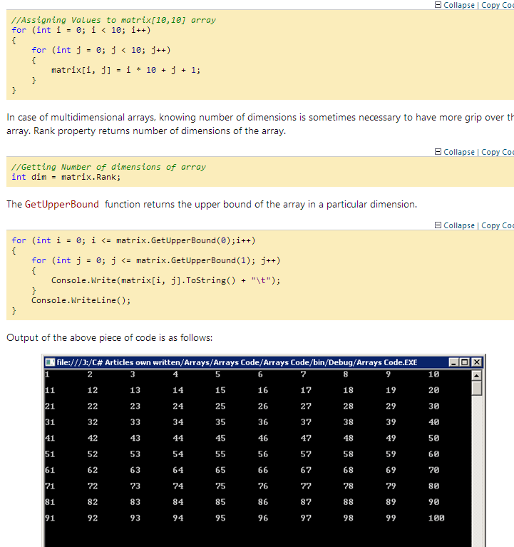
.GetLength(x) is more intuitive
http://www.codeproject.com/Articles/161465/Arrays-Basics-in-CSharpDotNetTech

Slide 37
Programmer’s Point
“Keep your dimensions low.”
1° You’ll almost never need more than 3 dimensions
2° Still need more? Revisit your problem and see if you can solve it using another aproach (for example by using 2 2D- arrays instead of one 4D)

Slide 38
Another example: dictionary
string[,] dictionary =
{
{"kast", "armoire","closet", "armario" },
{"kind", "enfant", "child","niño" },
};
Console.WriteLine("Gekende woorden:");
for (int i = 0; i < dictionary.GetLength(0); i++)
{
Console.WriteLine($"{i}:{dictionary[i, 0]}");
}
Console.WriteLine("Welk woord wil je vertalen? (geef nummer)");
int keuze = Convert.ToInt32(Console.ReadLine());
Console.WriteLine($"Vertalingen voor {dictionary[keuze, 0]}:");
for (int i = 1; i < dictionary.GetLength(1); i++)
{
Console.WriteLine(dictionary[keuze, i]);
}

Slide 39
Fun with methods revisited
Can you solve this method using an array of verbs?
string GenereerWerkwoord()
{
switch (r.Next(0, 10))
{
case 0: return "roept";
case 1: return "gooit";
case 2: return "aait";
case 3: return "eet";
case 4: return "pakt";
case 5: return "kijkt naar";
case 6: return "ledigt";
case 7: return "vecht met";
case 8: return "beklimt";
case 9: return "begraaft";
default:
return "IETS ONBEKENDS";
}
}

Slide 40
Summary
Two possibilities:
Pass single value of the array to the method => always by value
Pass full array to the method => always by reference
Click here to watch the above animation in your pdf:
https://ericlbarnesblog.files.wordpress.com/2016/06/pass-by-reference-vs-pass-by-value-animation.gif

Slide 41

Basics for a “RPG” game with 2D arrays of strings
https://apwt.gitbook.io/ziescherp/semester-1-appendix/all-in-projecten/4_mazegame

Slide 42
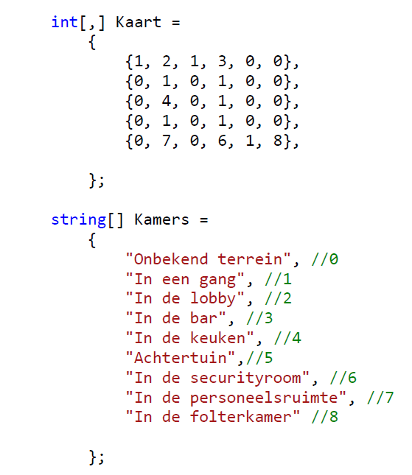
Code/walkthrough on digitap
Core idea: 2D “Look-up tables”

